Slide 1
Hand Gestures
Internet Of Things
Jeevena B S - 210701091
Janani Priya N - 210701086

Slide 2
Abstract
This paper presents the design and development of a Hand Gesture Vocalizer (HGV) prototype aimed at empowering disabled individuals with effective communication tools. The HGV utilizes advanced real-time gesture recognition technology to interpret hand movements into speech and text outputs, enabling users to express themselves fluidly. Integrated with Bluetooth connectivity, the device offers seamless interaction with various external devices and platforms. Moreover, it incorporates heartbeat monitoring integration for additional user insights and safety measures. The user-friendly interface ensures intuitive operation, facilitating accessibility for individuals with diverse abilities. Furthermore, the HGV prototype demonstrates adaptability to accommodate user preferences and evolving needs. Through this innovation, we strive to enhance the quality of life and foster inclusivity for disabled individuals by providing them with a versatile and empowering communication solution. This research contributes to the ongoing pursuit of inclusive design practices and underscores the transformative potential of innovative solutions in enhancing accessibility and autonomy for disabled populations.

Slide 3
Introduction
The Hand Gesture by a Dumb Person to Synthesized English Words which have a corresponding meaning in Sign Language which interprets a particular thing, as an Audio Output for Normal Person. communities by removing the communication gap between them. As sign language is a formal language employing a system of hand gesture for communication (by the deaf). In this project Flex Sensor Plays the major role, which are placed on fingers, as fingers bends it changes resistance depending on the amount of bend on the sensor.

Slide 4
Problem Statement
Addressing the challenges faced by India's substantial deaf and dumb population, constituting 20% of the global demographic, requires innovative solutions. The absence of effective communication exacerbates social isolation and limits access to education and employment. To bridge this gap, a user-friendly application is proposed. This application aims to seamlessly translate natural English sentences inputted by the hearing population into sign language gestures for the deaf-dumb community and synthesize sign language gestures inputted by the deaf-dumb into English audio output for the hearing population. By facilitating effective communication, this solution aims to enhance inclusivity, social integration, and empowerment for both communities.

Slide 5
Proposed Work
The project aims to develop an innovative application addressing the communication challenges faced by the deaf and dumb population in India, who constitute a significant portion of the global demographic. By utilizing Flex Sensors placed on fingers to detect gestures, the application will translate natural English sentences input by a normal person into sign language gestures for deaf individuals and synthesized English words for dumb individuals.

Slide 6
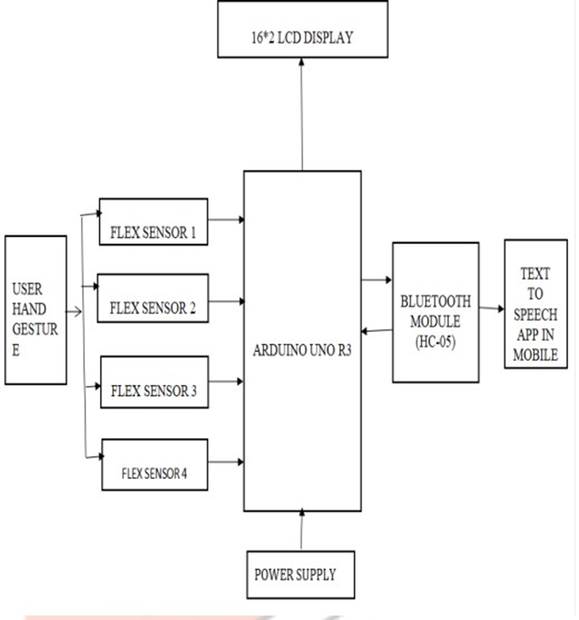
Architecture

Slide 7
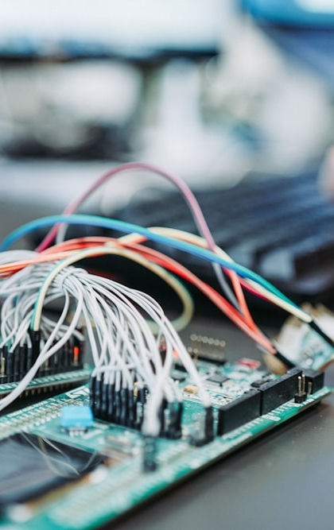
System Requirements
Processor | : | 12th Generation Intel® Core™ i5 processor
Memory Size | : | 256 GB (Minimum)
HDD BOARD SENSOR Bread Board Jumper Wire LCD | : : : : : : | 40 GB (Minimum) Arduino Uno Flex sensor Pulse oximeter and Heart Rate sensor 1 Required amount 16*2 Board

Slide 8
Advantages of the proposed system
The proposed system for hand gesture recognition and health monitoring using an Arduino, a pulse oximeter, and a Bluetooth module offers significant advantages. It enhances communication for non-verbal individuals, improving their quality of life and providing an accessible method to express needs and emotions through predefined gestures. The system also allows real-time health monitoring, continuously tracking heart rate and oxygen saturation levels with immediate alerts for timely intervention. Its compact design ensures portability and ease of use, while the user-friendly LCD display presents clear health data. Cost-effective and customizable, the open-source nature of the system makes it accessible and expandable. Furthermore, Bluetooth connectivity enables remote monitoring and notifications, facilitating better care and responsiveness.

Slide 9
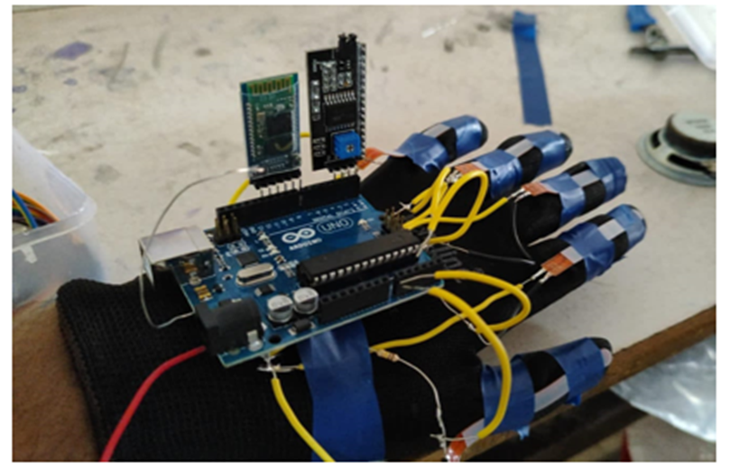
Hand Gestures

Slide 10
Implementation
To set up the Hand Gesture Vocalizer system, begin by connecting the Pulse Oximeter & Heart Rate Sensor, Bluetooth Module, and three Flex Sensors to the Arduino Uno using jumper wires. Then, use the I2C Interface to connect the LCD Display to the Arduino Uno for output. Employ connecting wires as needed to establish connections between components, ensuring proper functionality. Incorporate 10K resistors where necessary for voltage regulation. Finally, connect the Arduino Uno to a computer using the USB cable for power and programming. With this setup, the system is primed for testing and further refinement, aiming to enhance communication and interaction for individuals with disabilities.

Slide 11
Conclusion
In conclusion, the developed system effectively combines hand gesture recognition and real-time health monitoring to enhance communication and care for non-verbal individuals. By utilizing an Arduino integrated with flex sensors, a pulse oximeter, an LCD display, and a Bluetooth module, the system provides a practical and accessible solution for expressing needs and emotions while continuously tracking vital health metrics. The portability and user-friendliness of the system ensure ease of use, while its cost-effectiveness and open-source nature allow for customization and expansion. This innovative approach not only improves the quality of life for users but also facilitates better care and timely interventions through remote monitoring capabilities.

Slide 12
References
[1] K. K. T. Punsara, H. H. R. C. Premachandra, A. W. A. D. Chanaka, R. V. Wijayawickrama, A. Nimsiri, and R. De Silva, “IoT based sign language recognition system,” in ICAC 2020 - 2nd International Conference on Advancements in Computing, Proceedings, Institute of Electrical and Electronics Engineers Inc., Dec. 2020, pp. 162–167. doi: 10.1109/ICAC51239.2020.9357267.
[2] P. Ambavane, R. Karjavkar, H. Pathare, S. Relekar, B. Alte, and N. K. Sharma, “A Novel Communication System For Deaf And Dumb People using gesture,” ITM Web of Conferences, vol. 32, p. 02003, 2020, doi: 10.1051/itmconf/20203202003.
[3] K. Damodar, R. Harshavardhan Reddy, S. Shama Sulthana, A. Professor, and A. Professor, “International journal of basic and applied research Index in Cosmos EMPOWERING DISABLED COMMUNICATION: DESIGNING AND IMPLEMENTING GESTURE RECOGNITION SYSTEM,” UGC Approved Journal, vol. 11, no. 3, 2021, [Online]. Available:www.pragatipublication.com

Slide 13
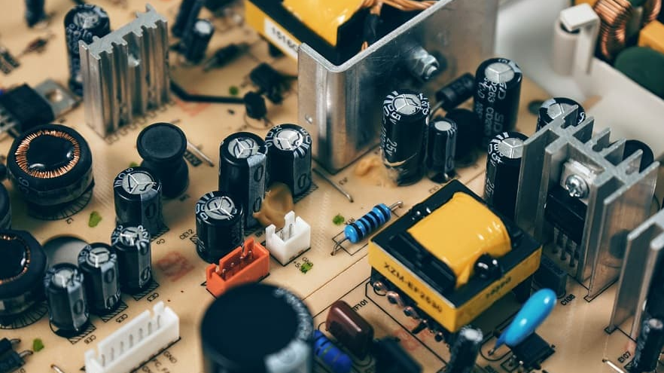
Queries

Slide 14
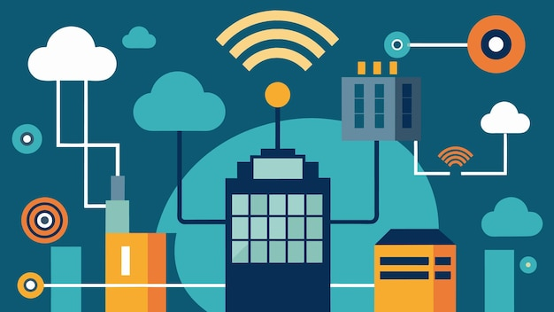
Demonstration

Slide 15
Thank you!

